Slide 1
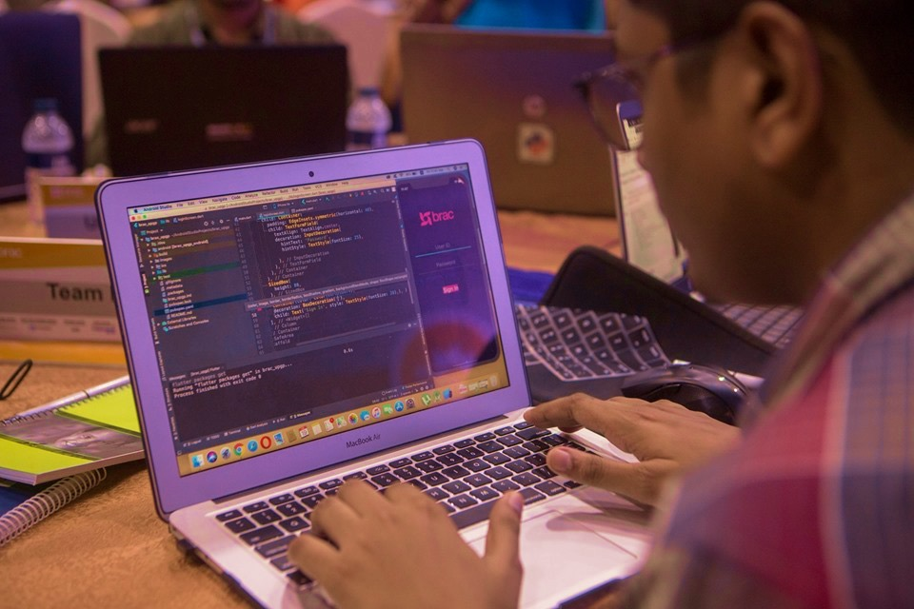
A simple solution

Slide 2

সমৃদ্ধি

Slide 3
Our process is easy
Login
Create Custom
Templates
Get Basic Analysis

Slide 4
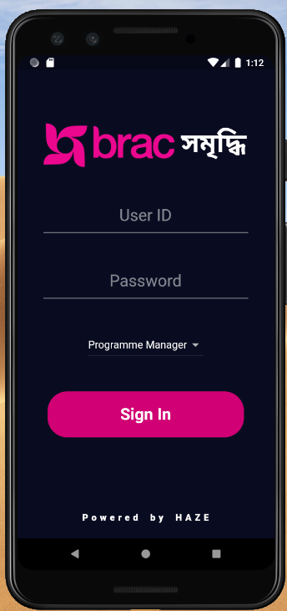
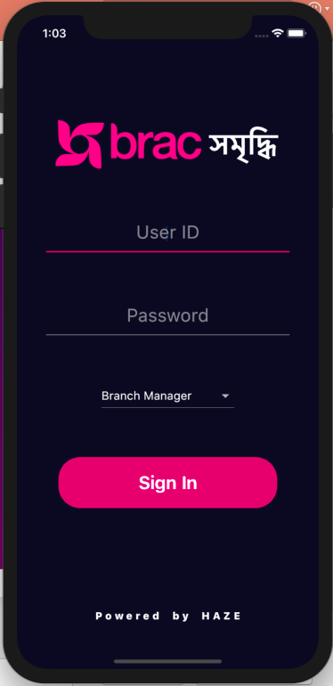
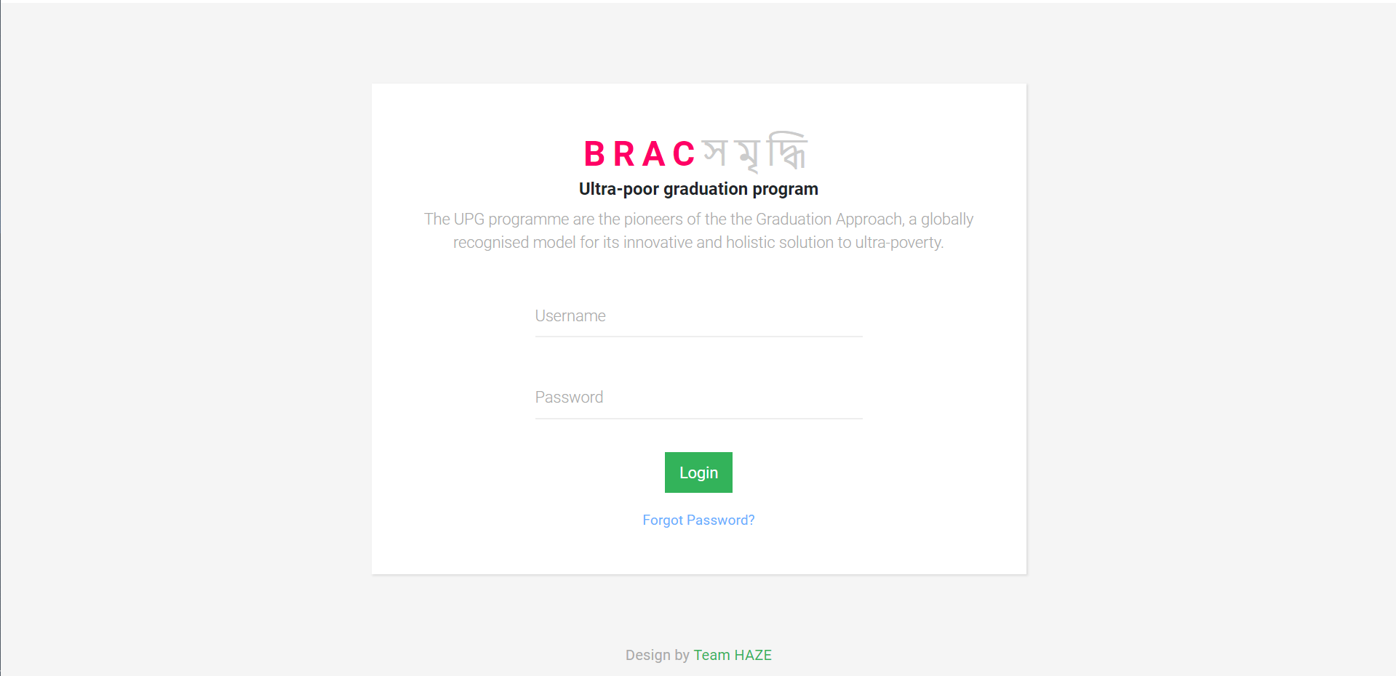
Easy-To-Access
User Friendly
Flexible
Efficient

Slide 5
Web
Android
iPhone

Slide 6
Our Team Name Might Be ‘HAZE’ But Our Solution Is As Clear As Daylight.

Slide 7
Thanks!

